Slide 1

Backpack Alley
DATABASE SYSTEMS PROJECT GROUP 5: JEFF LEUPOLD, ALICIA GARCIA, FANGSHENG XU

Slide 2
Project Overview
We are aiming to build a prospering backpack company that meets the following criteria
Scales efficiently
Listen to our customers through data
Reduce manufacturing costs through data
Operate in an agile environment
Our Project’s Mission
Make running a backpack manufacturing business easier
Provide organized information of products, retailers and inventory
Prioritize manufacturing high selling/rating products

Slide 3
Business Problem
Our business needs to manage multiple moving components of a business:
Supply chains
Customer Orders
Vendor Orders
Our business wants to avoid common mistakes due to misinformed decisions like
Overstocking underselling products
Poor customer experiences due to missing order information
Mismanaged sensitive customer information
To ensure we don’t join the 20% of new businesses that fail within the first 2 years a successful business, we are investing in a database.

Slide 4
Benefits from a Database
Make two-way door decisions
Track customer purchases and ratings
Predicts users’ shopping interests
Helps with investment decision
Help adjusting our sale strategy
Tracks popularity of our products
Track vendor orders
Increase cost-profit ratio
Monitor inventory for each product

Slide 5
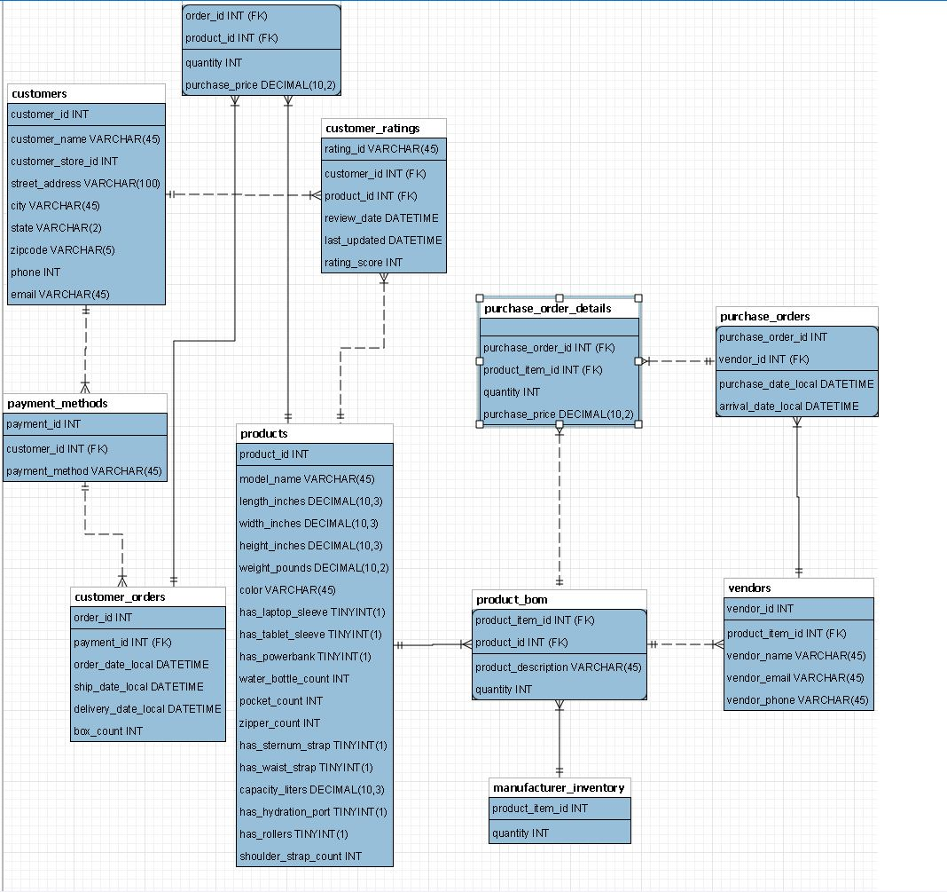
Overview of Database EER

Slide 6
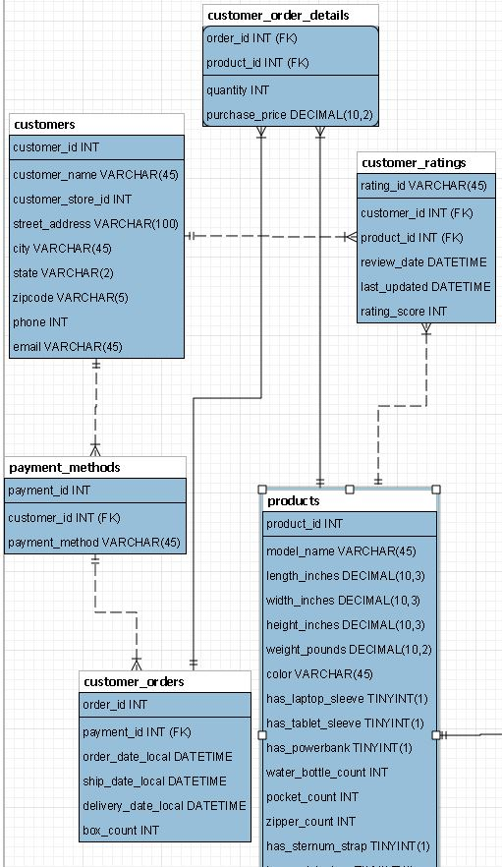
Customer orders EER
In our business, we purchase materials from various vendors, manufacture backpack and sell them to our customers. This portion of EER is for selling to our customers and our products’ rating

Slide 7
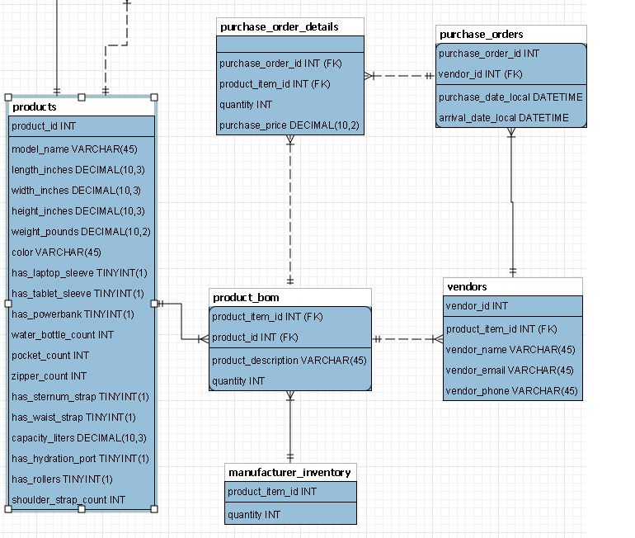
Company’s material purchases
This portion is for our purchases from material vendors.

Slide 8
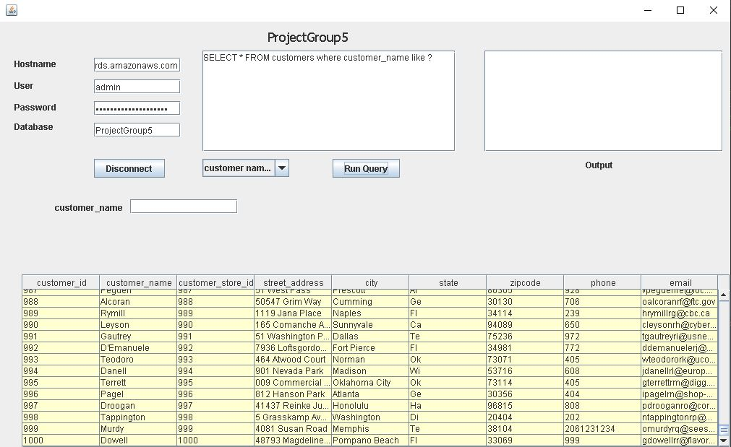
Backpack Alley Query GUI
Connect to the db with the click of a button
Report names displayed in the drop down
Add/remove reports with no software update

Slide 9
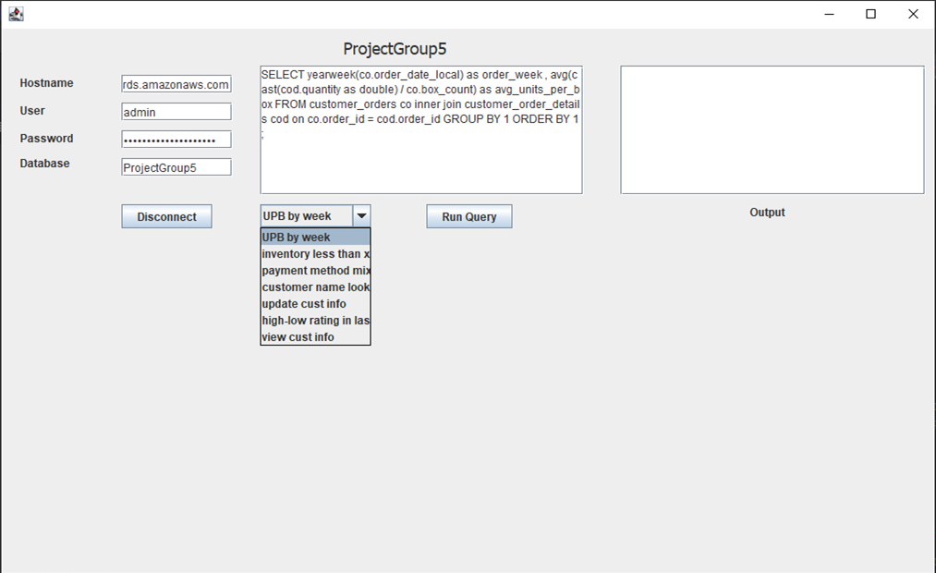
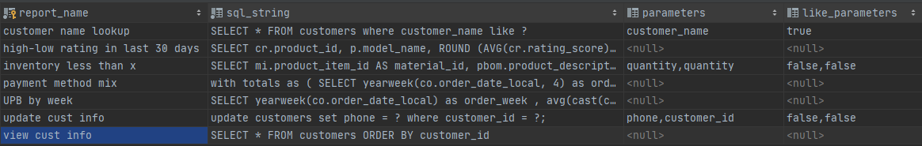
Adding Reports
Must have a reports table in the database
Parameters column is list of column names separated by a comma
Like_parameters
Similar structure as parameters
Each value corresponds to value in parameters string
Always ‘true’ or ‘false’

Slide 10
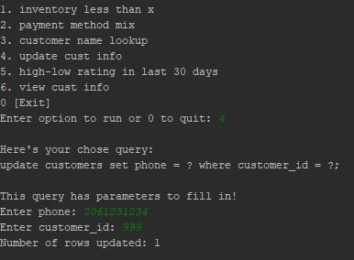
Backpack Alley Query Console
List of available queries are displayed for the user
Select a query and the query is displayed (Action Query)
Parameters are entered to update the table

Slide 11
Query Runner Road Map
Future Enhancements
Import database credentials from text file
Export results to Excel
Allow users to create and save their own reports
Expand drop down to view entire report name
Pagination in the console version

Slide 12
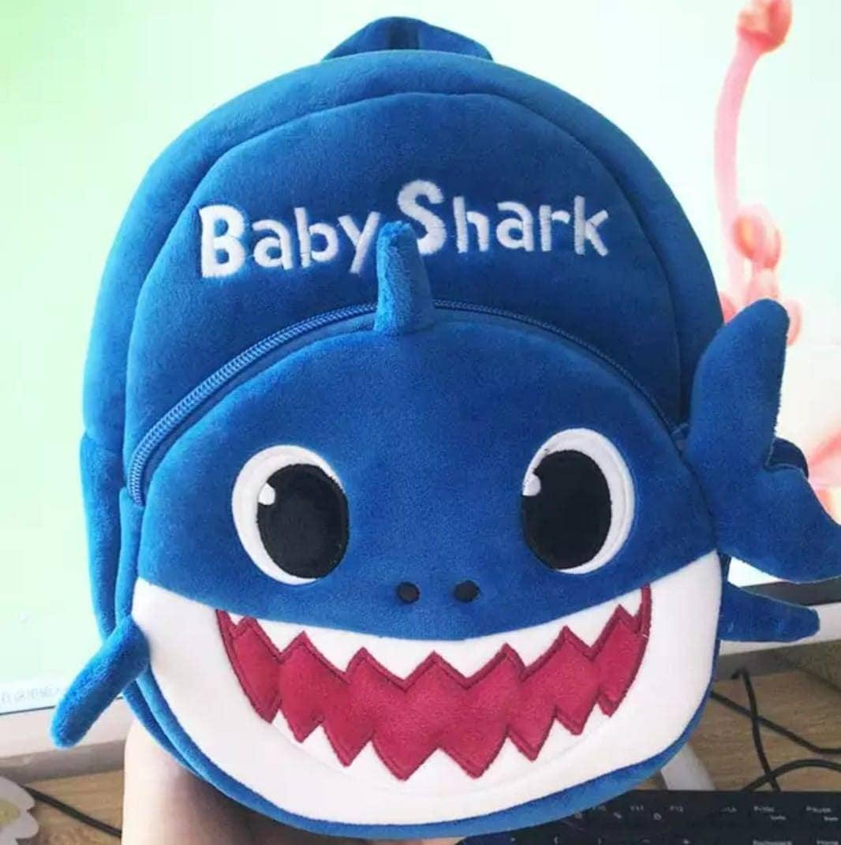
Thank You!

